Slide 1


Department of Computer Science and Engineering
PROJECT PHASE II REVIEW
CRYPTOVOTE: BLOCKCHAIN-INSPIRED E-VOTING SYSTEM
PROJECT GUIDE:
TEAM MEMBERS:
Mrs.K.GANDHIMATHI , M.E., (Ph.D)., ASSISTANT PROFESSOR
DHANUSH K [22CS061]
GIRIDHARAN P [22CS074]
GOKULNATH K [22CS078]
DATE OF PROJECT PHASE II REVIEW : 29/04/2026

Slide 2
ABSTRACT
Secure and transparent electronic voting is essential for maintaining trust in elections, yet traditional voting systems rely heavily on centralized control, making them vulnerable to manipulation.
Existing e-voting platforms often face issues such as vote tampering, data manipulation, and lack of transparency, which reduce voter confidence and trust in the electoral process.
The project presents CryptoVote, a blockchain-inspired e-voting system designed to ensure transparency, security, and tamper-proof elections.
Each vote is converted into a cryptographically secure block and linked sequentially using SHA-256 hashing, forming an immutable blockchain that guarantees data integrity and confidentiality.
The system provides a secure web-based interface for voter authentication, vote casting, transaction verification, and generates accurate, auditable election results directly from blockchain records using Python, FastAPI, and JSON-based storage.

Slide 3
PROBLEM STATEMENT
Existing electronic voting systems rely on centralized databases that are vulnerable to manipulation and single-point failures.
Traditional online voting platforms lack strong mechanisms to ensure vote integrity, transparency, and tamper resistance.
Manual supervision and centralized control reduce voter trust and increase the risk of fraud and unauthorized access.
Due to these limitations: vote manipulation is possible, transparency is low, auditability is limited, and result verification is unreliable.
There is a pressing need for a secure, transparent, and tamper-proof e-voting system that ensures voter authenticity, vote integrity, and reliable election outcomes.

Slide 4
LITERATURE SURVEY
Author Names & Year of Publication | Techniques | Advantage | Problem Identified
M. G. Saleh, H. A. Danang Rimbawa (2025) | Hybrid e-voting system combining blockchain with GPS-based polling station verification | Improves election integrity by ensuring voters are physically present at valid locations | Requires GPS infrastructure and additional hardware support
K. Kiashemshaki, M. Jalili Torkamani et al. (2025) | Blockchain-based voting with hybrid consensus and lightweight cryptography | Improves scalability and efficiency of blockchain voting systems | Still faces complexity in implementation and system integration

Slide 5
LITERATURE SURVEY
Author Names & Year of Publication | Techniques | Advantage | Problem Identified
Y. Tahboub, A. Revilla, J. Lynch (2025) | Hybrid blockchain system using private blockchain with public chain anchoring | Ensures voter anonymity while maintaining verifiability | Partial centralization reduces full decentralization benefits
A. Poudel, U. Poudel et al. (2025) | Quantum-secure blockchain voting with biometric authentication | Provides future-proof security against quantum attacks | High complexity and need for advanced infrastructure

Slide 6
LITERATURE SURVEY
Author Names & Year of Publication | Techniques | Advantage | Problem Identified
G. Somasekhar et al. (2024) | Blockchain-based digital voting integrated with distributed ledger and cryptography | Maintains transparency, integrity, and reliability of voting process | Scalability challenges in large-scale elections
M. Sharp (2024) | Comparative blockchain e-voting system with advanced counting methods (Borda & Condorcet) | Improves accuracy and reliability of election results | Complex system design and implementation challenges

Slide 7
PROPOSED WORK METHOD
The proposed system introduces CryptoVote, a blockchain-inspired electronic voting system for secure and transparent elections.
It uses cryptographic SHA-256 hashing to convert each vote into a secure and immutable block.
A sequential block-linking mechanism ensures that every vote is permanently connected to the previous one.
The system includes secure user authentication and voter verification to prevent unauthorized and duplicate voting.
By combining blockchain principles with lightweight data storage, it ensures vote integrity, transparency, and reliable result generation.

Slide 8
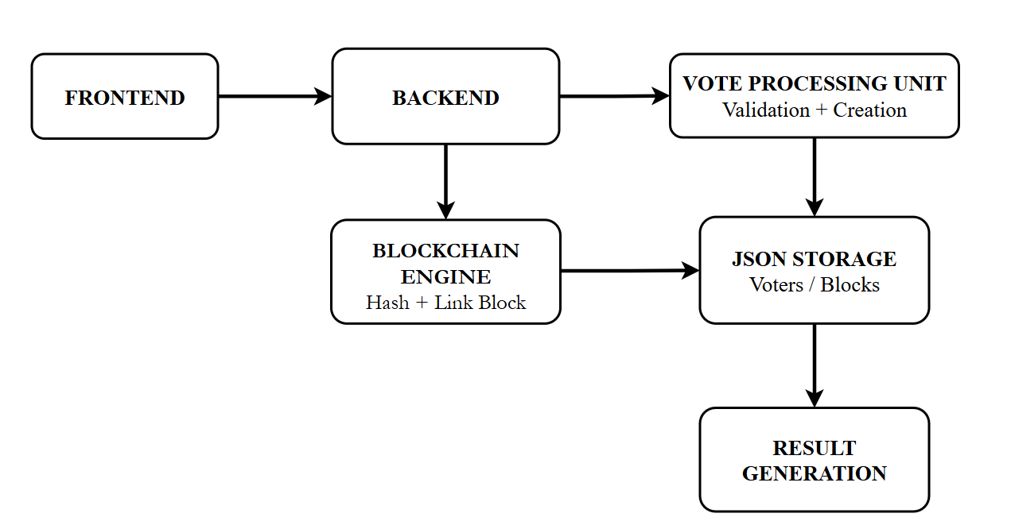
BLOCK DIAGRAM

Slide 9
TOOLS AND COMPONENTS
HARDWARE REQUIREMENTS:
Processor (CPU): Intel Core i7 (Minimum requirement for smooth execution of blockchain logic).
Graphics Card (GPU): NVIDIA GPU with at least 8 GB VRAM
Memory (RAM): 16 GB (Recommended for running IDEs and local blockchain simulations simultaneously).
Storage: 256 GB SSD (Minimum) / 512 GB SSD
SOFTWARE REQUIREMENTS:
Operating System: Windows 10
Programming Language: Python 3.8
IDE / Development Environment:
VS Code and Jupyter Notebook (For testing the SHA-256 hashing modules and data visualization).

Slide 10
MODULE LIST
1.User Registration & Authentication Module
  Handles secure user registration and login.
2. Voter Verification Module
  Confirms voter eligibility before allowing voting access.
3. Candidate Management Module
  Allows admin to add, update, or remove candidates.
4. Vote Processing & Validation Module
  Accepts vote request from verified voters.
5. Blockchain Block Creation Module
  Generates SHA-256 hash for each vote,Links each block sequentially.
6. Secure JSON Storage Module
  Uses structured JSON files for lightweight storage.
7. Admin Dashboard Module
Allows admin to monitor election progress,Access final results.

Slide 11
INPUT
INPUT PROCESSING
User login credentials such as username and password are provided through the voting interface.
Voter verification details including voter ID and personal information are submitted for eligibility validation.
The selected candidate choice is captured during the vote casting process.
All input data is securely transmitted to the backend for authentication and vote processing. .

Slide 12
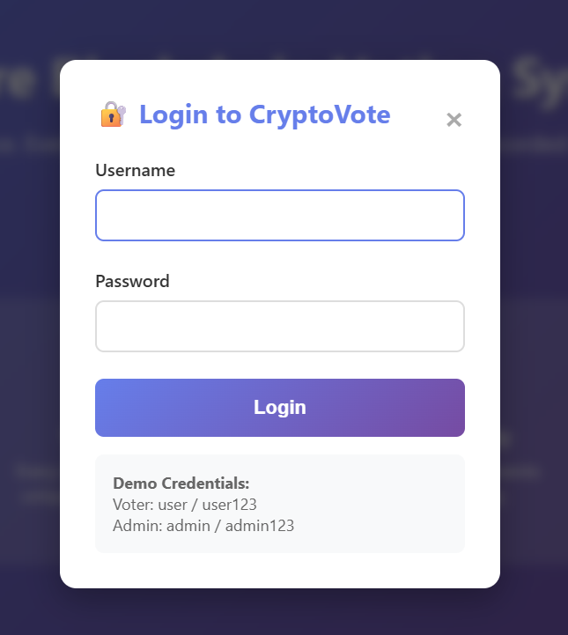
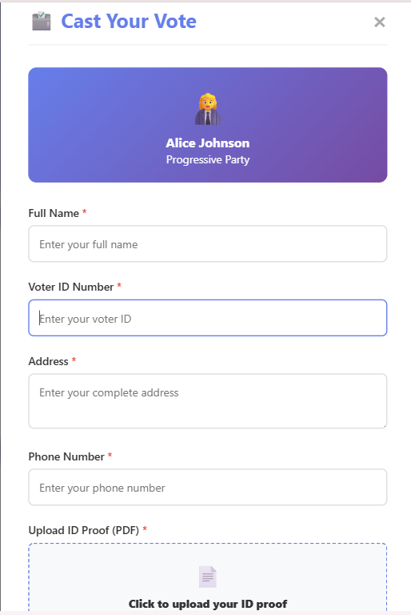
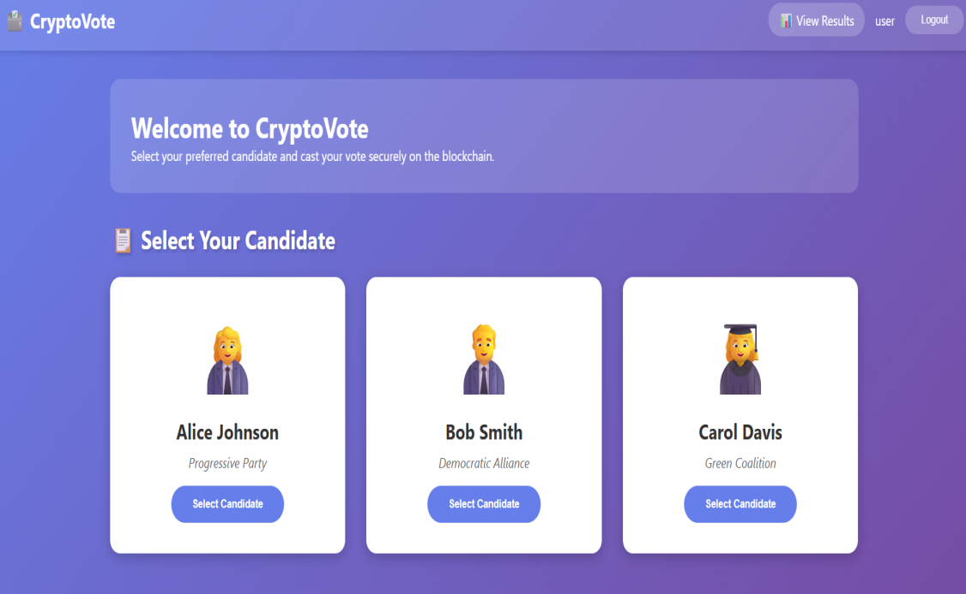
INPUT AND USER DASHBOARD

Slide 13
OUTPUT
Votes are securely stored as immutable blockchain blocks using cryptographic hashing.
The system provides vote confirmation to the voter after successful submission.
Election results are generated accurately from blockchain records.
Administrators can view verified results and audit vote integrity.

Slide 14


ADMIN DASHBOARD AND OUTPUT

Slide 15
CONCLUSION
The proposed CryptoVote system integrates blockchain principles with secure vote processing to ensure transparency and tamper-proof electronic voting
It includes effective authentication, vote validation, block creation, and result generation stages to enhance election reliability.
The use of cryptographic hashing and immutable block linking improves vote integrity and strengthens trust in the electoral process.
The system provides an efficient, automated, and practical solution for secure digital elections across institutions of varying sizes.
In the future, the system can be extended with biometric authentication, mobile voting support, and scalability enhancements for large-scale elections.

Slide 16
REFRENCE
▪ Kiashemshaki, K., Jalili Torkamani, M., et al.
“Secure Blockchain-Based Voting Using Hybrid Consensus and AI Techniques.”
IEEE International Conference on Blockchain and Cryptocurrency (ICBC),
Volume No: 7, 2025.
▪ Poudel, A., Poudel, U., et al.
“Quantum-Secure Blockchain Voting System with Biometric Authentication.”
IEEE International Conference on Cybersecurity and Cryptography,
Volume No:6, 2025.
▪ Saleh, M. G., and Rimbawa, H. A. D.
“Hybrid Blockchain-Based E-Voting System with GPS Verification.”
International Journal of Scientific Research and Modern Technology, Volume No: 4, 2025.

Slide 17
REFRENCE
▪ Sharp, M., Njilla, L., Huang, C.-T., and Geng, T.
“Blockchain-Based E-Voting Mechanisms and Advanced Counting Methods.”
MDPI Network Journal, Volume No: 4, Issue No: 4, 2024.
▪ Somasekhar, G., Jinka, S., Kanekal, C. K., and Marouthu, A.
“Digital Voting with Blockchain using IPFS and PBFT.”
Engineering, Technology & Applied Science Research, Volume No: 14,
Issue No:6, 2024.
▪ Tahboub, Y., Revilla, A., and Lynch, J.
“Hybrid Blockchain Architecture for Secure and Verifiable E-Voting.”
IEEE International Conference on Secure Computing and Networking,
Volume No: 5, 2025.

Slide 18
THANK YOU

